Slide 1
Supporting stem cell research with modern data management technologies
Dr. Stefanie Seltmann
22 & 23 October 2018 • IMI Scientific Symposium • Brussels, Belgium

Slide 2
Induced Pluripotent Stem Cells
pluripotent
stem cells (PSC)
reprogramming
patient cells
transdifferentiation
PSC-derived cells
drug testing
tubular epithelium
organoids
cell replacement therapy
podocytes
disease modelling

Slide 3
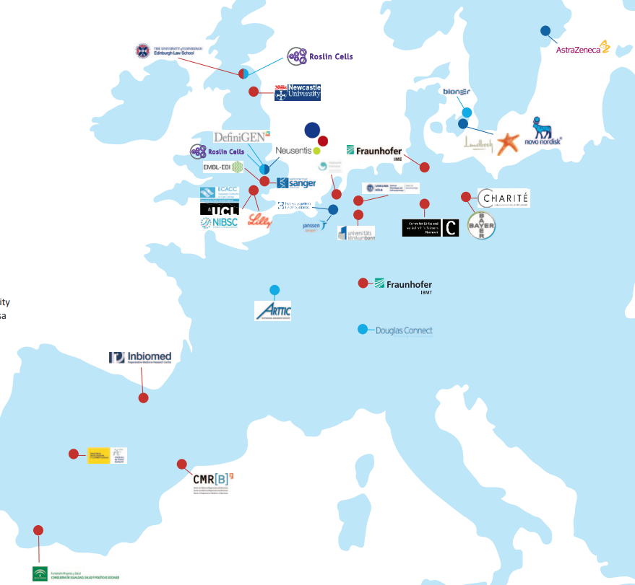
EBiSC
Notes:
3

Slide 4
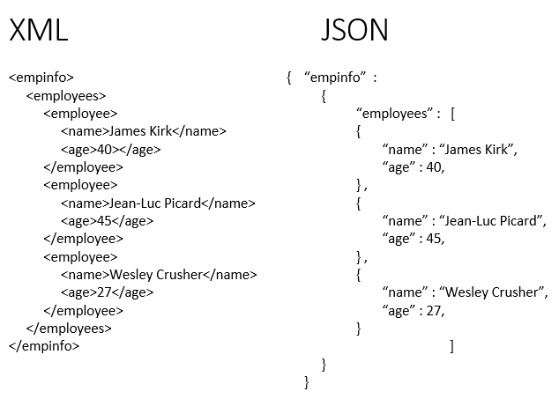
EBiSC Information Management System (IMS)
IMS
Depositor Management
Customer Webportal
Cell Line Batch Information
Knowledge Base Management
E-Commerce
Order Management
Clinical Data
Ethical Provence
Inventory
Publication Tracking
JSON
XML
JSON
JSON
hPSCreg
XML
EBI
XML
Central Facility
ECACC
Initial data package from depositor

Slide 5
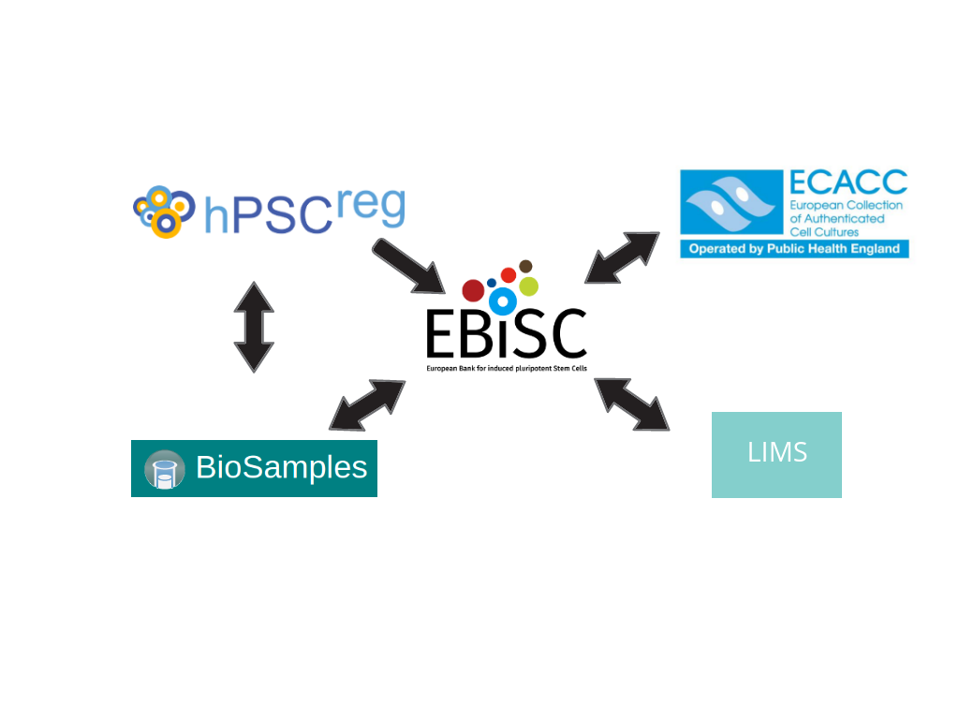
EBiSC Data Tracker
Daily check for reachability of every endpoint

