Slide 1
Highly potent heavy chain only antibodies protect against
MERS-CoV infection
Nisreen Okba
PhD candidate, Erasmus Medical Center, Netherlands
22 & 23 October 2018 • IMI Scientific Symposium • Brussels, Belgium

Slide 2
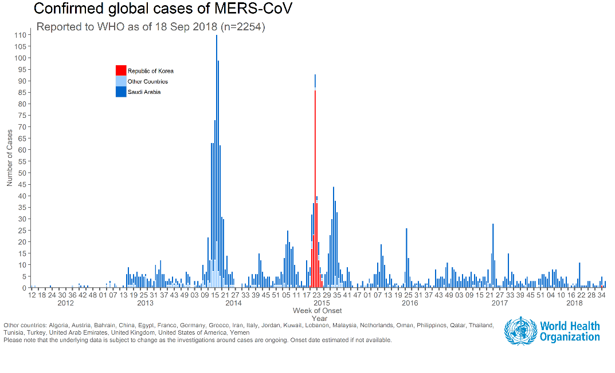
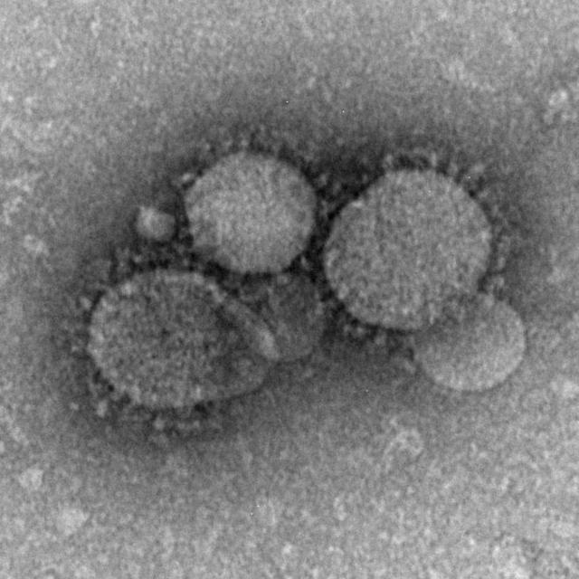
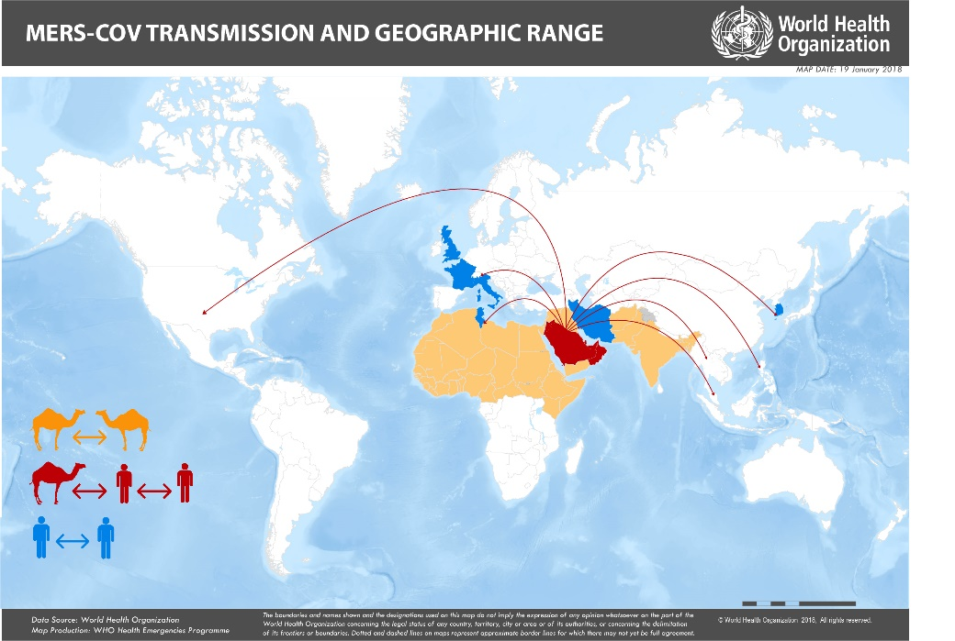
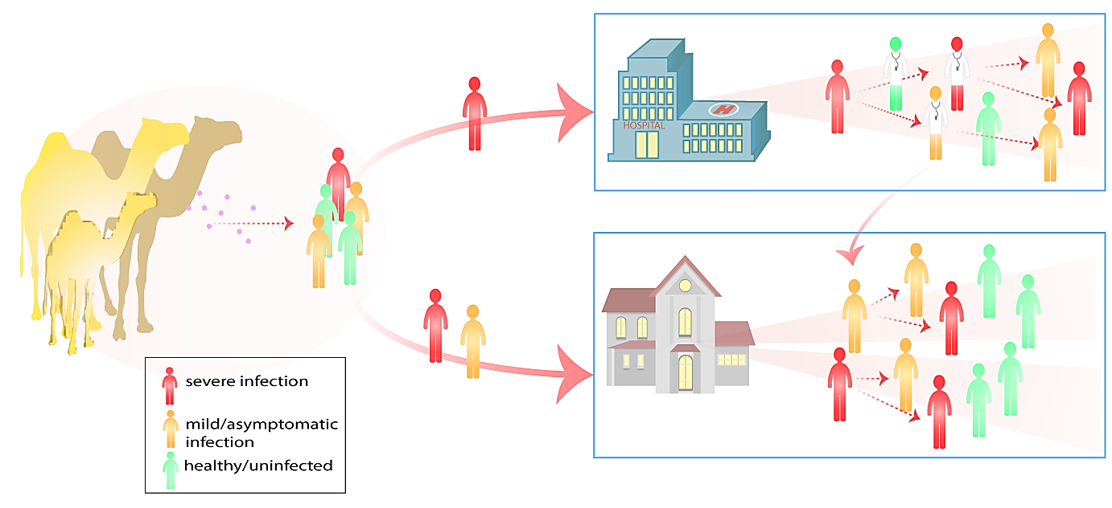
Middle East respiratory syndrome coronavirus (MERS-CoV)
(CFR 35.5%)
Emerged in 2012
Reservoir: Dromedary camels
Asymptomatic to fatal infections
Case fatality rate: 35.5%
Ongoing outbreaks
No Vaccine or treatment available
Mabs
Coronaviruses (CoVs) are enveloped viruses with positive-sense RNA genome
Covs are found in humans and animals
4 human CoVs normally cause a common cold
HCoV-NL63
HCoV-229E
HCoV-OC43
HCoV-HKU1
2 zoonotic CoVs cause severe respiratory infections and death
SARS-CoV
MERS-CoV

Slide 3
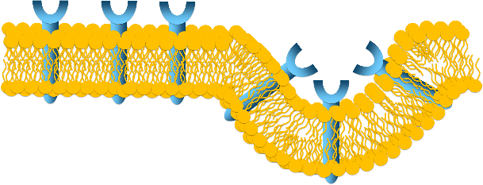
MERS-CoV neutralizing antibodies
Binding
Entry
Infection
Protection
Cell
membrane
Virus Neutralization
MERS-CoV
Receptor
Spike protein
Mediates binding and entry
Generate MERS-CoV neutralizing nanobodies
Naturally infected dromedary camels have remarkably high levels of neutralizing antibodies against MERS-CoV
Camelids naturally have Heavy chain only antibodies (HCAbs)
Light chain
Heavy chain
Single domain antibodies (VHH, nanobody)
Small (15 kDa)
Target unique epitopes (poorly recognized by classical antibodies)
High affinity for the Ag
Highly stable and soluble
High expression yields
Easy editing in laboratories
Less immunotoxic
VHH
single domain antibody
≈ 15 KDa
IgG Immunoglobulin
≈ 150 KDa
HCAb
≈ 80 KDa
Notes:
Naturally infected dromedary camels have remarkably high levels of neutralizing antibodies against MERS-CoV
Camelids naturally have Heavy chain only antibodies (HCAbs)
Single domain antibodies (VHH, nanobody)
Small (15 kDa), highly stable and soluble
Target for classical antibodies inaccessible targets
Easy editing in laboratories
Less immunotoxic

Slide 4
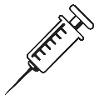
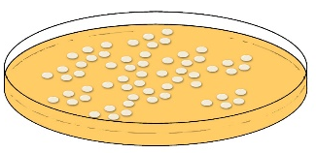
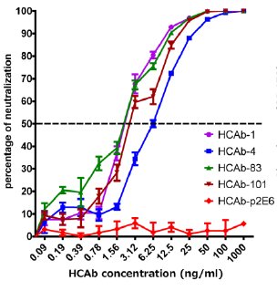
MERS-CoV neutralizing nanobodies
I. Nanobody library Generation
I. Nanobody library Generation
II. Screening for MERS-CoV neutralizing Nbs
III. Generation of camel/human chimeric antibodies & testing in-vivo
in vitro neutralization
in vivo Protection
Bone Marrow
VHH cloning and Expression
Nanobody (VHH)
Library N=504
Immunization+infection
Survival?
4 potent neutralizing Nbs
2
4
6
8
20 ug
200 ug
control
Days post infection
II. Screening for MERS-CoV neutralizing Nbs
NB LIBRARY (N=504)
46 Neutralizing Nbs
(receptor binding domain)
Prophylactically
6hr before challenge
HCAb-83
IC₅₀=30 pM
in vitro blocking assay
virus neutralization assay
Sequencing
Human Fc
ELISAs
Virus neutralization
4 potent neutralizing Nbs
IC₅₀ < 0.1 ug/ml
Camel/human chimeric Heavy chain only antibody (HCAb)

Slide 5
Conclusions
MERS-CoV neutralizing nanobodies blocked MERS-CoV infection at picomolar concentrations
When fused to a human Fc , these nanobodies protected mice against a lethal challenge with MERS-CoV
Due to their high affinity, in vivo stability and efficacy, these MERS-CoV-specific cHCAbs could be promising candidates for the development of MERS-CoV intervention measures

