Slide 1

Physical Activity as a Crucial Patient Reported Outcome in COPD
Demeyer Heleen
22 & 23 October 2018 • IMI Scientific Symposium • Brussels, Belgium

Slide 2
Physical activity in patients with COPD
Conventional definition
Any bodily movement produced by skeletal muscle resulting in energy expenditure (Caspersen, Public Health Rep, 1985)
Exacerbation
Mortality
Translation to patients
How do patients the concept “physical activity”?
Is “the concept” important for patients?
QoL
Dyspnea
Exercise tolerance
FEV₁
Balance
Bone mineral density
Physical
Activity
Pooled data of research group
KU Leuven
Gimeno-Santos, Thoax, 2014
PROactive group

Slide 3
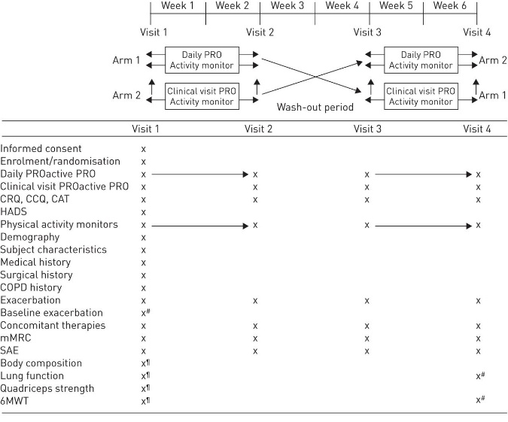
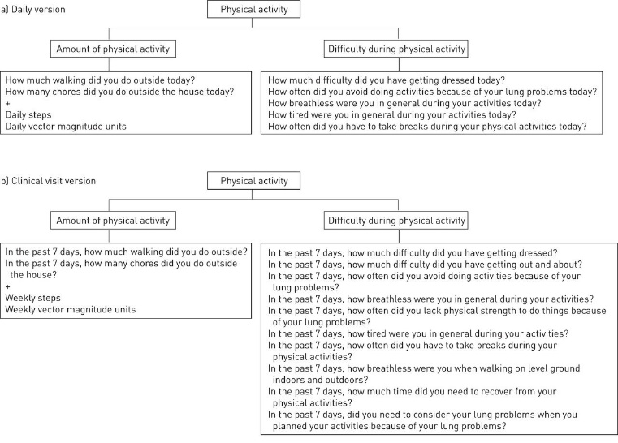
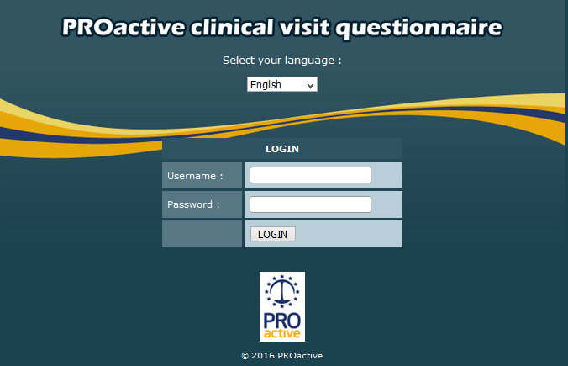
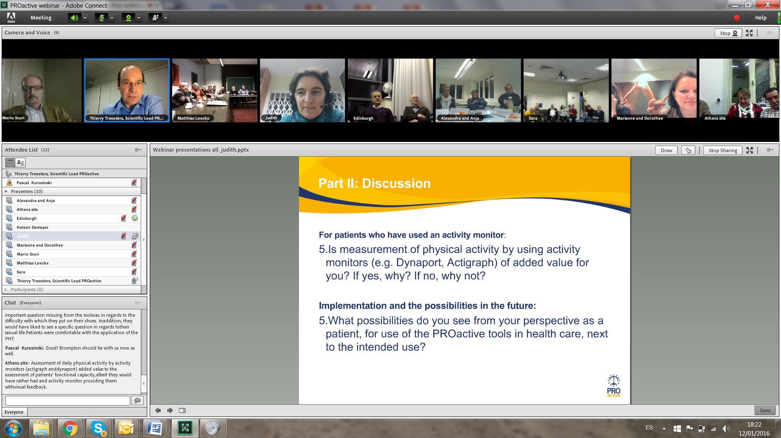
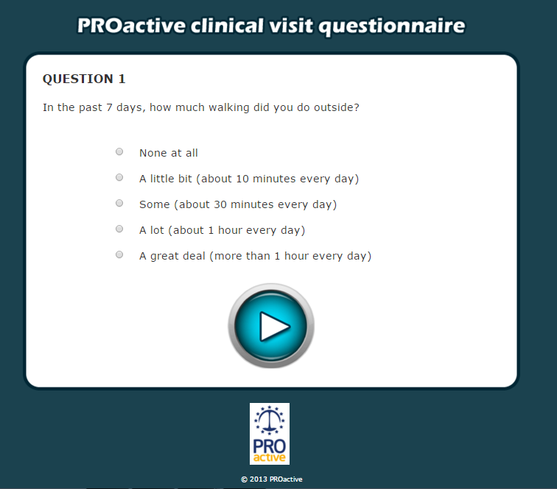
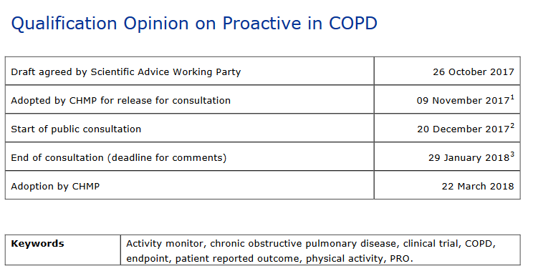
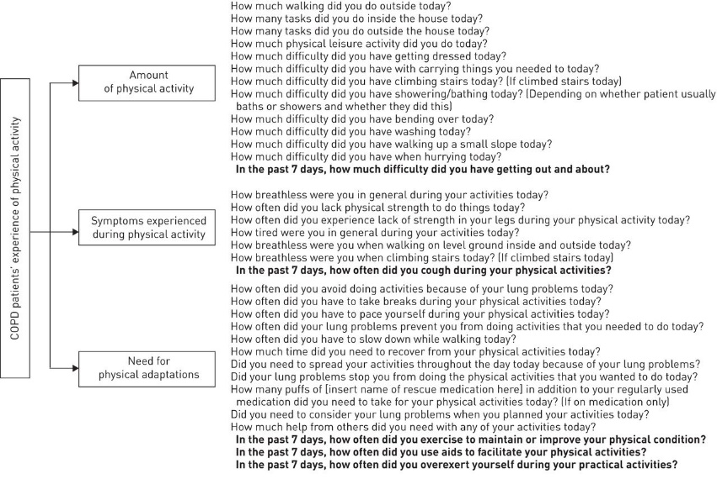
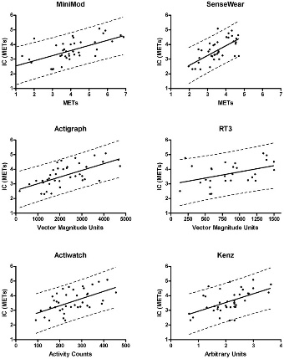
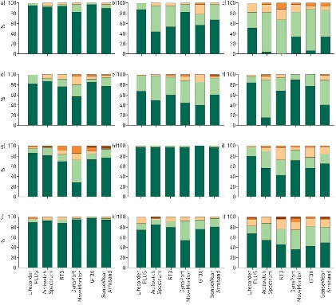
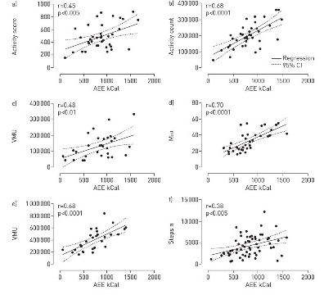
Overview of the project
Sources
Discussion Guide
Sources
Selection of Activity monitors
Discussion Guide
Selection of Activity monitors
Patients
WP2B
Patients
WP2B
Validity and reliability in several languages
EFPIA studies (baseline)
Collaborations through MOU
Focus Groups
WP2B
Focus Groups
WP2B
Validation
(Validity and usability)
WP2D
Responsiveness in several treatment paradigms
Validation
(Validity and usability)
WP2D
Initial Item Pool
Experts
WP2C
Initial Item Pool
Experts
WP2C
Telecoaching
Exercise training
Pharmacotherapy
Combinations of the above
Cognitive debriefing
WP2B
Cognitive debriefing
WP2B
Literature
WP2A
Troosters, AJRCCM, 2018
Arbillaga-Extrarri, ERJ, 2018
Demeyer Thorax 2017
Framework Troosters Resp Res 2013
Literature
WP2A
Reduced Item Pool
Chosen Activity monitor
Reduced Item Pool
Chosen Activity monitor
Gimeno-Santos Eur Respir J 2014
Gimeno-Santos Eur Respir J 2014
Initial PROs
On-line repository
WP3
Initial
Validation Study in patients
WP4
Draft PROs
Clinical Validation studies
WP6 A-C
Final PROs validated
Van Remoortel PLoSone 2012; Van Remoortel IJBNPA 2012; Rabinovich, ERJ, 2013
Dobbels Eur Respir J 2014
4 systematic reviews published

Slide 4

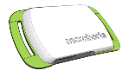
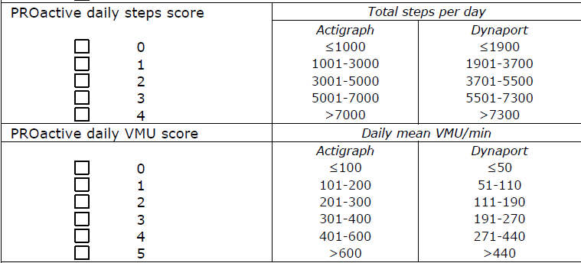
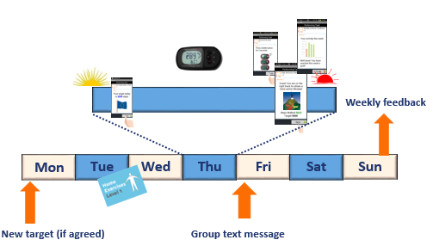
Achievements of the project
Directly related to milestones
Successful development along FDA-EMA guidance of a Patient Reported Outcome tool introducing an innovative HYBRID concept (D-PPAC & C-PPAC) which has been qualified by EMA
  Developed simultaneously in four EU languages /cultures /patient populations (50+ culturally sensitive translations available for global use in research)
PROactive D-PPAC
Not directly related to main milestones
Amount of activity
- How much walking did you do outside today?
- How many chores did you do outside the house today? Some examples are gardening, taking the rubbish outor doing small , errands.
- Activity monitor
Physical activity on the agenda
SOP for many outcome measures, PA as an outcome measure
New interventions developed for patients
Complex design studies conducted by EFPIA
Highly cited peer-reviewed publications
Used in clinical trial to help supporting labelling claim
Difficulty
How tired were you in general during your activities today
How often did you have to take breaks during your physical activities today
How breathless were you in general during your activities today
How much difficulty did you have getting dressed today
How often did you have to avoid doing things because of your lung problems today

Slide 5


Achievements of the project - personal
PhD
2011-2015 (Wp4 – WP6)
Coordinating multicenter RCT
Network
Edinburgh
CV
Groningen
Peer-reviewed papers
Post-doctoral stay
London
Leuven
Zurich
Athens
Future
Further collaborations with partners (academic and non-academic)
Partner in new IMI-project

