Slide 1
EURECA - Substudy of infections due to carbapenem-resistant Enterobacteriacea (CRE) along Europe.
Inside COMBACTE network: global information for a global problem.
María Paniagua
22 & 23 October 2018 • IMI Scientific Symposium • Brussels, Belgium

Slide 2


INTRODUCTION. BACKGROUND
2009
2013
2015
2016
EURECA STUDY
Klebsiella pneumoniae CR
EUropean prospective cohort study on Enterobacteriaceae Showing REsistance to CArbapenems
10 countries
50 sites
More than 200 investigators
More than 2,000 patients
Academic
Industry
Biotech
Public-Private
Partnership

Slide 3
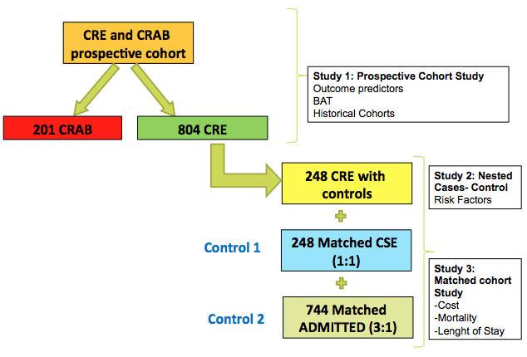
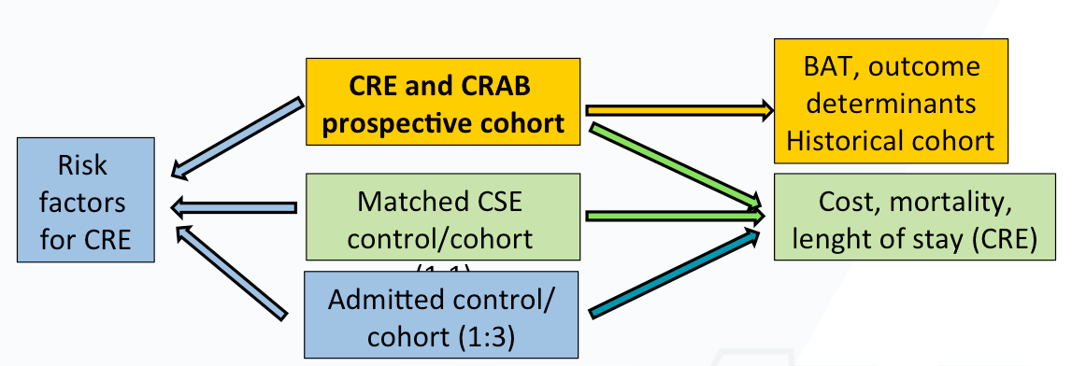
INTERIM ANALYSIS
276 CRE cases
115 cUTI
65 IAI
28 PN
38 BSI
DESIGN. OBJETIVES
TARGETED CRE INFECTIONS
Complicated urinary
tract infection (cUTI)
Intra-abdominal (IAI)
Pneumonia (PN)
Bacteremia (BSI)

Slide 4
EURECA. Substudy 1.
CRE prospective cohort. Interim Analysis Main Results
EPIDEMIOLOGY | All 276 n (%) | cUTI 115 n (%) | IAI 65 n (%) | PN 28 n (%) | BSI 68 n (%)
Healthcare associated Nosocomial | 61 (22) 198 (72) | 39 (34) 65 (56) | 7 (11) 56 (86) | 6 (22) 18 (64) | 9 (13) 59 (87)
Medical Service Surgical ICU | 134 (48) 74 (27) 66 (24) | 76 (66) 28 (24) 10 (9) | 21 (32) 33 (51) 11 (17) | 13 (46) 3 (11) 12 (43) | 24 (35) 10 (15) 33 (49)
Nosocomial/Healthcare-associated infections
Presence in all services (Source-related)
RISK FACTORS | All 276 n (%) | cUTI 115 n (%) | IAI 65 n (%) | PN 28 n (%) | BSI 68 n (%)
Antibiotics use (3mo) | 234 (85) | 95 (84) | 57 (88) | 25 (89) | 57 (84)
Another CRE at same ward | 89 (37) | 24 (21) | 29 (44) | 6 (24) | 30 (44)
Previous Hospitalisation (6mo) | 172 (62) | 77 (67) | 44 (68) | 16 (57) | 35 (52)
Central line (3mo) | 133 (48) | 35 (30) | 35 (54) | 13 (46) | 50 (74)
Urinary catheter (3mo) | 202 (73) | 95 (83) | 37 (57) | 18 (64) | 52 (77)
Mechanic Ventilation (3mo) | 88 (32) | 12 (10) | 25 (39) | 12 (43) | 39 (57)
Surgery last month | 89 (32) | 22 (19) | 34 (52) | 9 (32) | 24 (35)
Prev. CRE colonization/infection | 69 (25) | 26 (23) | 19 (29) | 9 (32) | 15 (22)
High rates of previous ATBs use (85%)
High rates of CRE patients in the same ward
High rates of previous hospitalisation
High rates of previous “hospital procedures”
(Source-related)
Considerable rates of previous CRE colonization/infection
OUTCOMES | All 276 n (%) | cUTI 115 n (%) | IAI 65 n (%) | PN 28 n (%) | BSI 68 n (%)
Clinical cure (day 21) | 120 (44) | 60 (52) | 31 (50) | 4 (14) | 25 (37)
Microbiological cure (day 21) | 133 (48) | 71 (70) | 44 (68) | 18 (64) | 39 (47)
All cause mortality (day 30) | 57 (21) | 19 (17) | 6 (9) | 3 (11) | 29 (42)
Related mortality (day 30) | 25 (10) | 8 (17) | 5 (8) | 1 (4) | 22 (32)
Length of hospital stay (med (IQR) | 20 (13-25) | 19 (14-23) | 23 (16-29) | 32 (17-30) | 16 (10-24)
Low rates of Clinical Cure at day 21 (<50%)
Acceptable Microbiological Cure at day 21 (50-70%)
Variable mortality (Source-related)
Long hospital stay associated

Slide 5
CONCLUSIONS
GLOBAL PROBLEMS → GLOBAL APPROACH → GLOBAL SOLUTIONS
PUBLIC-PRIVATE → COLLABORATION → TEAMWORK
Multinational and multihospital level of information is crucial in Antimicrobial Resistance,
given the importance of providing global and confident information
EURECA STUDY
Adequate recruitment
Results from interim analysis suggest we will answer the objectives.

